Slide 1
Mileage Reimbursement for Resource Parents
Office of Child & Family Services
Department of Health & Human Services
July 2023 V4

Slide 2
Resource Parents
The Travel Forms are used to reimburse travel expenses to:
Bring children to and from medical visits.
Bring children to visitations with family.
Under special circumstances with prior approval by OCFS
Bring children to and from school, childcare or other activity that is pre-approved by OCFS Caseworker.
Resource Parent Travel Reimbursement form is used to reimburse mileage @ $.46 cents per mile, effective March 1, 2023.
The Resource Parent Mileage Reimbursement form has been updated to calculate and total all entries. This version was created in Microsoft/Excel.
A blank mileage form is also available.
This Photo by Unknown Author is licensed under CC BY-SA

Slide 3
Mileage Forms for Travel within the State of Maine
The travel documented on the form is for travel within the State of Maine only.
A Resource Parent can fill out the form and submit it electronically to the assigned caseworker. A Resource Parent can sign the form electronically and submit it electronically with an email explanation.
The form can also be handwritten but must be fully legible and the resource parent must physically sign his/her name.

Slide 4
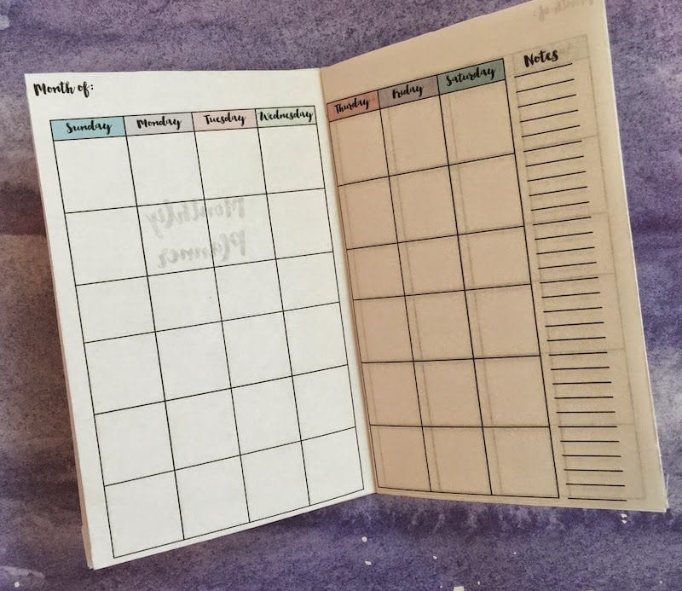
Mileage Forms Submitted Monthly
Start the mileage form at the beginning of the month, January for example.
The mileage form will include mileage for month of January ONLY.
The resource parent can electronically sign the form, if the form is electronically submitted.
The completed form is then sent to the assigned caseworker; either in hand, by US mail or by email.
The request for reimbursement needs to be submitted each month and submitted timely.
For Example: January 2023 expenditures need to be submitted before the end of February 2023. One form completed for one calendar month.
This Photo by Unknown Author is licensed under CC BY-NC-ND

Slide 5
How to Complete the Mileage Form
The following information is required:
The name of the resource parent requesting the reimbursement.
The complete SSN of the resource parent requesting the reimbursement. This is to ensure the correct person receives the reimbursement.
The date of the travel.
The name of the child/youth(s) in care being transported.
The Case Name (if different from the child transported) (ask the caseworker).
The caseworker assigned to the case.
The child’s A number as found in the Child’s MaineCare insurance card.
The Case ID number (if not known ask the Caseworker for this number).

Slide 6
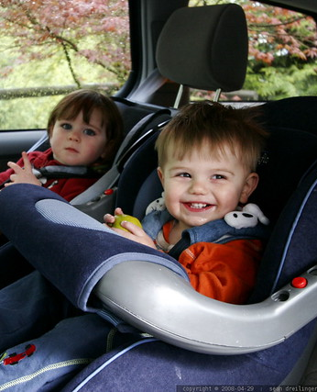
What do the codes mean? What if you transport two children?
Codes
M92 for trips to MaineCare Provider/MaineCare Services
N92 for trips to visit with the Birth Parent
R92 for all other trips (Example – to school or to childcare) – OCFS preapproval required.
If one child is transported, enter the total mileage for a round trip in whole numbers.
If two children are transported in the same car – one row for one child with half of the miles and then one row for the second child with half of the miles.
Clearly state that two children were transported at the same time and the purpose of the travel.

Slide 7
The form also needs the following information.
The date of travel.
The destination (from Augusta to Gardiner and back to Augusta) (no abbreviations).
The reason for travel (only if R92 code is used), clearly described.
The Service Code (M92 or N92 or R92).
Service Codes are defined on the previous slide.
The actual miles traveled for the round trip.
The rate per mile (.46 cents for Resource Parents).
Other Trip Expenses (tolls or parking – receipts required for other expenses).
Resource Parent’s Signatures are required in order to process the payment.

Slide 8
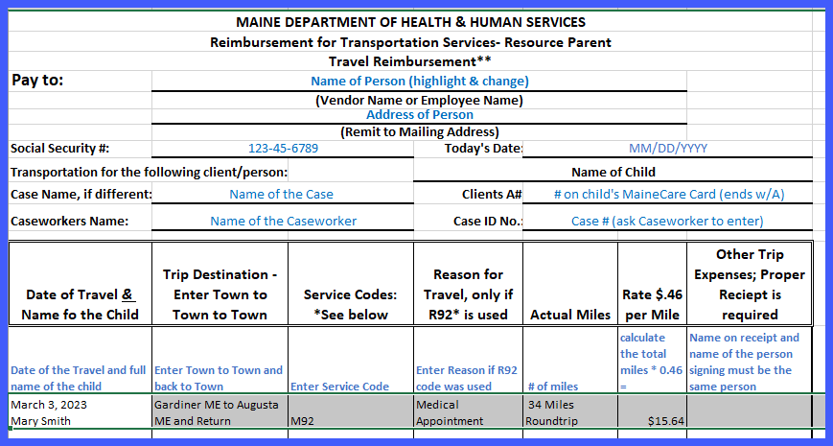
Each line = One Round Trip

Slide 9
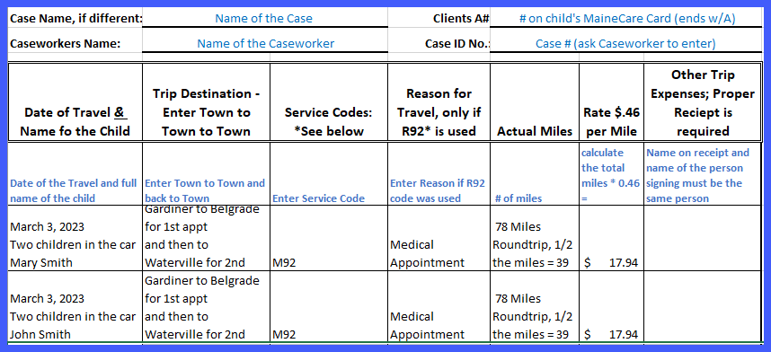
Example Trip for Two Children

Slide 10
Caseworker Duties
The caseworker receives the mileage form and receipts from the Resource Parent.
The Caseworker will review the completed reimbursement form for accuracy; no abbreviations and verify the totals.
The Caseworker will ensure that the child’s name, A number and Case ID are on the form.
Once reviewed by the caseworker, the caseworker will sign and date the form (electronically or physically).
The Caseworker will submit the completed form to the Supervisor for review.
The Supervisor will review the information for accuracy. The Supervisor will sign and date the form (electronically or print the form and physically sign).

Slide 11
Complete the Service Authorization Payment Process
Once the Caseworker and Supervisor review and approve the reimbursement form, it is delivered to the Office Assistant.
The Office Assistant will review the accuracy of the information and process the form and receipts.
The Office Assistant will scan the completed form and receipts into the system used by the DHHS Accounts Payable team.
The DHHS Accounts Payable team will process the Mileage Reimbursement form with the proper receipts.
The estimated time between the Resource Parent submitting the Travel form and receipts to the time the payment arrives is between three and four business weeks.

Slide 12
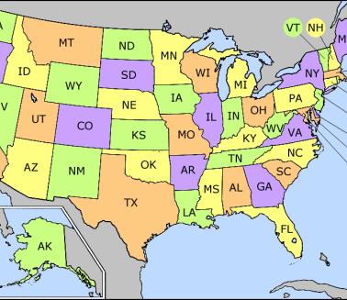
Travel Outside the State of Maine
If you are traveling out of the State of Maine with a foster child, you must work with your caseworker to receive prior approval for this travel. Your caseworker will submit the approval paperwork and will notify you when OCFS has approved this travel.
Travel out of state is not reimbursable unless the travel is due to the medical needs of the child. The travel may be related to provide visitation opportunities to a parent outside of the state or other pre-approved reason.
We do not reimburse travel expenses for vacations.
In order to receive reimbursement, you would use the same reimbursement form as when submitting for travel in the State of Maine.

Slide 13
Questions?
Thank you for your participation in this training.
If you have any additional questions, please call the OCFS caseworker.

