Slide 1
Mileage Reimbursement for Parents
Office of Child & Family Services
Department of Health & Human Services
July 2023 V3

Slide 2
Parents
The Travel Forms are used to reimburse travel expenses to:
Meet child(ren) during medical appointments and the child is transported by the Resource Parent.
Meet child(ren) at a location for a planned visitation.
Parent Reimbursement is reimbursed at a rate of .22 a mile.
This Photo by Unknown Author is licensed under CC BY-SA

Slide 3
Mileage Forms for Travel within the State of Maine
The travel documented on these forms are for travel within the State of Maine only.
The fillable form accompanies this training.
The form has been updated to calculate mileage and total all entries.
A parent can fill out the form and submit it electronically to the assigned caseworker. A parent can sign and submit the form electronically with an email explanation.
A blank form is also available. If the form is handwritten, it must be fully legible, and the parent must physically sign his/her name. The parent will then mail or deliver the completed form to the caseworker.

Slide 4
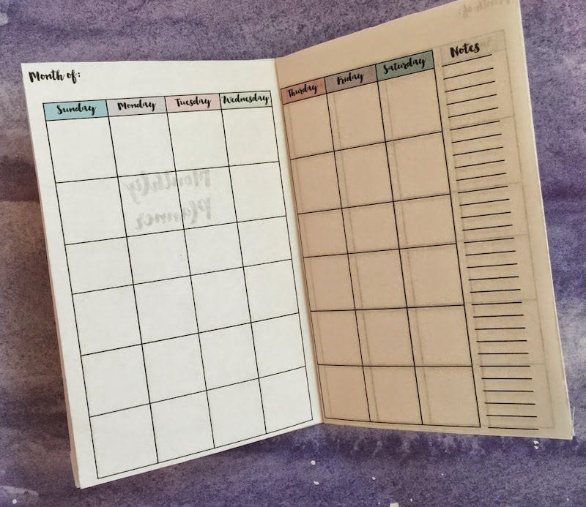
Mileage Forms Submitted Monthly
Start the mileage form at the beginning of the month, January for example.
The mileage for the month of January needs to include mileage for only this month.
The parent can electronically sign the form, if the form is electronically submitted.
The completed form is then sent to the assigned caseworker; either in paper, in person or in email.
The request for reimbursement needs to be submitted each month and submitted timely.
For Example: January 2023 expenditures need to be submitted before the end of February 2023. One form must only include expenditures for that one month.
This Photo by Unknown Author is licensed under CC BY-NC-ND

Slide 5
How to Complete the Mileage Form
The following information is required:
The name of the parent requesting the reimbursement.
The Social Security Number (complete) of the parent requesting the reimbursement. This is to ensure the correct person receives the reimbursement.
The date completed.
The name of the child/youth(s) in care.
The Case Name (if different from the child).
The child’s A number.
The caseworker assigned to the case.
The Case ID number.
Questions? Ask your Caseworker

Slide 6
The form requires the following information.
date of travel.
The date of travel.
The destination (from Augusta to Waterville and return) (no abbreviations).
The reason for travel.
The Service Code (M92 or N92).
Service Codes (defined on the next slide).
The actual miles traveled for the round trip.
The rate per mile (.22 cents for parent).
Other Trip Expenses (tolls or parking – receipts required for other expenses).
Parent’s Signature is required in order to process payment.

Slide 7
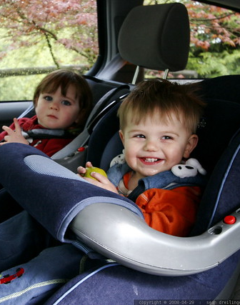
Information on Codes
M92 MaineCare Services; the parent drives to the child’s medical appointment.
N92 for Visit with the Parent; the parent drives to the planned visit with the child.

Slide 8
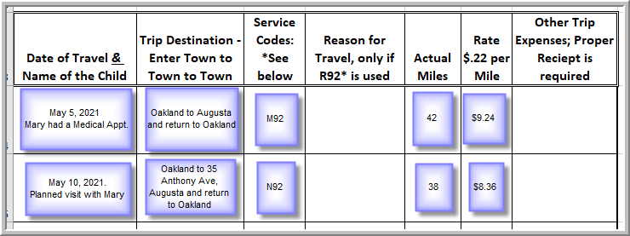
Each line = One Round Trip

Slide 9
OCFS/DHHS Duties
The caseworker receives the mileage form and receipts from the parent.
The caseworker will review the completed reimbursement form for accuracy and sign the form.
The Case Supervisor will also review the reimbursement form for accuracy and sign the form.
The office assistant will submit the form and receipts for processing with DHHS Finance and Budget.
The processing time for these steps is approximately three to four business weeks.

Slide 10
Questions?
Thank you for your participation in this training.
If you have any additional questions, please call the OCFS Caseworker.

