Slide 1
Reimbursement for Purchases G-31
Office of Child & Family Services
Department of Health & Human Services
April 2023 V2

Slide 2
Reimbursement is for Purchases
The reimbursement is for purchases made for a child in DHHS custody; this is not income earned from any form of employment.
The G-31 form requires a date of completion, the person requesting reimbursement must provide their entire Social Security number, full name and full mailing address.
The fillable G-31 form can be typed or handwritten. Receipts are required. The receipt must be in the same name as the name on the G-31 form, signed by the person whose name is on the receipt.
This form is not used for Child Care expenditures.

Slide 3
Caseworker Duties
The Caseworker and the Resource Parent need to discuss the child’s needs before agreeing to reimburse purchases.
The items must be in the best interest of the child and consistent with the goals of the case.

Slide 4
Reimbursement is for Purchases
Once the Caseworker and the Resource Parent identify specific needs. The Resource Parent will make specific purchases and submit for reimbursement.
Examples are:
Infant supplies; cribs, baby scale, formula, crib linen, car seats
Household safety supplies such as safety gates
Clothing, shoes, boots
Educational opportunities; dance lessons, karate lessons, school supplies and some sporting equipment.
Some items such as driver’s education and summer camp are different and are not reimbursed to the Resource parent. Please ask the Caseworker about these steps.

Slide 5
The request for reimbursement needs to be submitted one month at a time and submitted timely to the child’s Caseworker.
For Example:
Expenditures for any day within January of 2023 needs to be submitted by the last day of the following month, February of 2023.
And…Only January expenses can be included in the G-31 form (for the month of January 2023).
This Photo by Unknown Author is licensed under CC BY-SA

Slide 6
G-31 Form Typed or Handwritten
The form allows space for:
The date of purchase,
The client's name (child in care),
The child's A number (MaineCare Number),
A description or explanation of
the item purchased,
The dollar amount.
The total value is a calculated field.
Note: A Resource parent might not know the Child’s A number. The child’s A number is on the child’s MaineCare card. A Caseworker will ensure that the child’s A number is included.

Slide 7
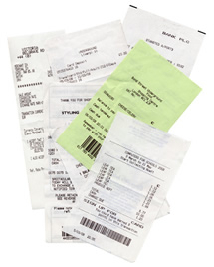
Receipts
Receipts must accompany the G-31 form.
The receipt must be legible and provide proof that a payment was made.
The receipt must have the date of the purchase and the name of the business or the name of the person who sold the article.
The price/value of the purchase must be clearly visible on the receipt.
If the receipt includes the name of the person making the purchase, that same person must sign the G-31 form.

Slide 8
Receipts
Resource parents:
Can electronically save the G-31 form and type on the form, including their name on the signature line.
Can take pictures of the receipt(s) and submit with the G-31 Form.
The completed form and receipts can be sent to the caseworker through email.
Alternatively, the Resource Parent can print the form and receipts and deliver in paper to the caseworker.

Slide 9
Caseworker Duties
Once the purchases are complete and the Resource Parent has completed the form and provided copies of receipts; then the Caseworker will review the accuracy of the information.
The caseworker will sign the G-31 form, electronically or the form can be printed and signed.

Slide 10
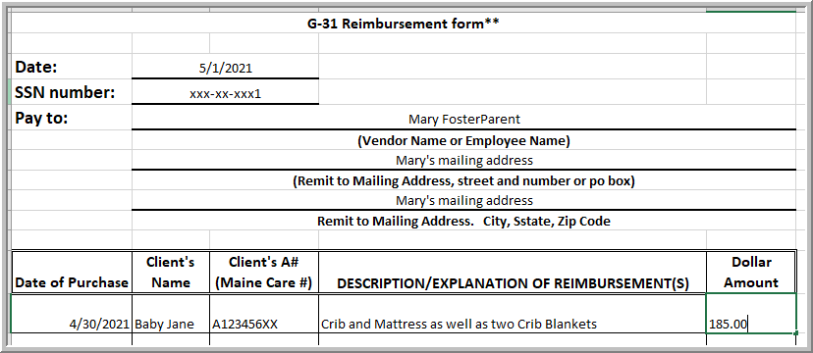
Example G-31

Slide 11
The form is used for Families or Caseworkers
The G-31 form is to be used for Resource Families; the reimbursement will not be considered taxable income.
Do not use the form to shop at a business, this is not a purchase order.
Once the G-31 Reimbursement and receipts are complete and approved by the Caseworker and the Supervisor, all information is prepared for processing by the Office Assistant.
The Office Assistant sends the form and receipts to DHHS Finance and Budget for payment.
The process will take approximately three to four business weeks.

Slide 12
The G-31 Form accompanies this presentation
The fillable form is in the form of an excel spreadsheet, which accompanies these directions.
Please type within the form, versus writing by hand, this will help to ensure accuracy.
Please remember to complete this form for a one-month period and submit the form within 30 days.
Example: January 2023 purchases must be submitted by the end of February 2023 and only include purchases made during the month of January 2023.

Slide 13
Questions?
Thank you for participating in this training offered by the Office of Child and Family Services
Please contact your assigned Caseworker
with any questions.

