Slide 1
Student Learning Objectives
September 10, 2018
Augusta, Maine

Slide 2
Opening Remarks
Emily Gribben, Educator Effectiveness Coordinator
Email: emily.gribben@maine.gov
Phone: 207-624-6748

Slide 3
Chapter 180: PEPG Systems

Slide 4
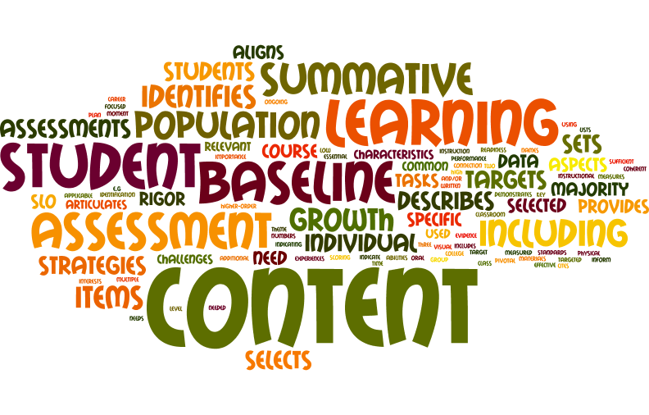
What do you know about SLOs?

Slide 5
What is an SLO?
It is… | It is not…
a long-term goal for students | a collection of daily lesson plans
crafted for a group of students | crafted for individual students
developed in collaboration | given to a teacher completed
an instructional methodology | a compliance routine

Slide 6
Agendas
Determining SLO Quality
Navigating an SLO Process
Deciding on Learning Content
Setting Growth Targets
Developing Quality Assessments

Slide 7
Determining SLO Quality

Slide 8
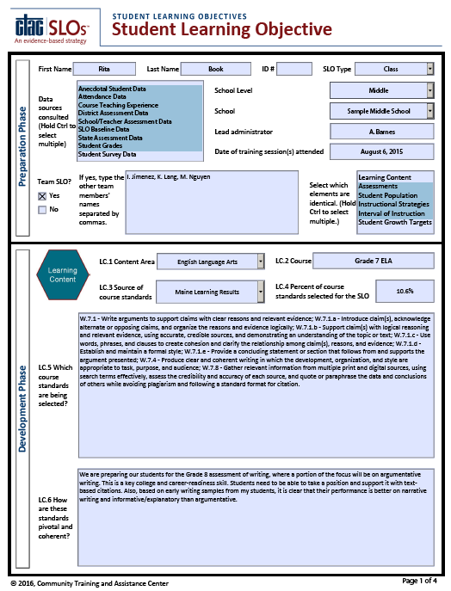
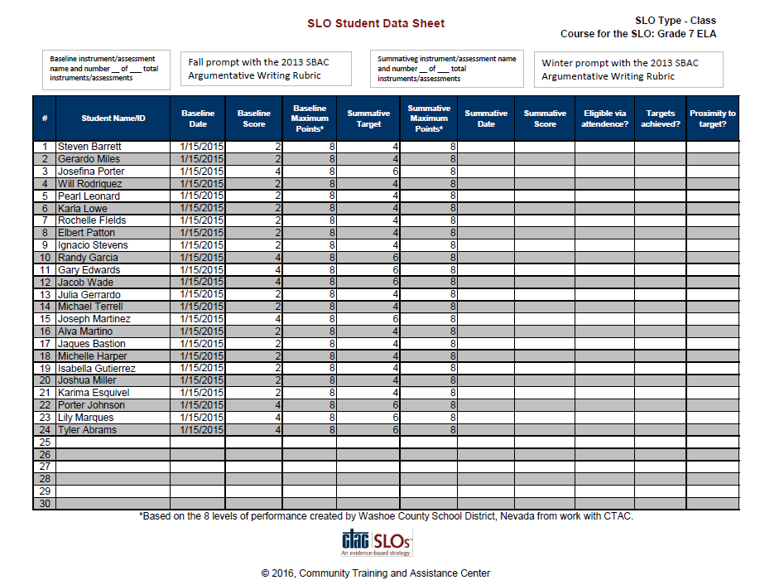
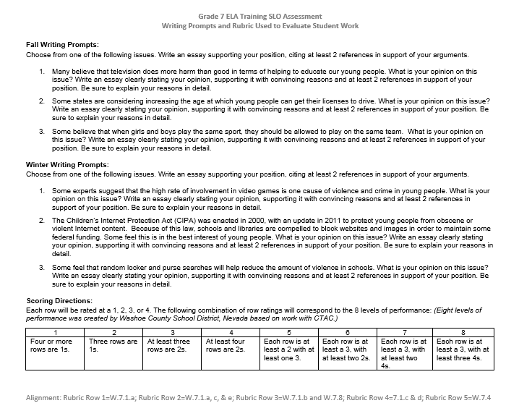
Reviewing an SLO – Grade 7 ELA
Read a sample SLO
Jot notes on:
Higher quality features of the SLO
Lower quality features of the SLO

Slide 9
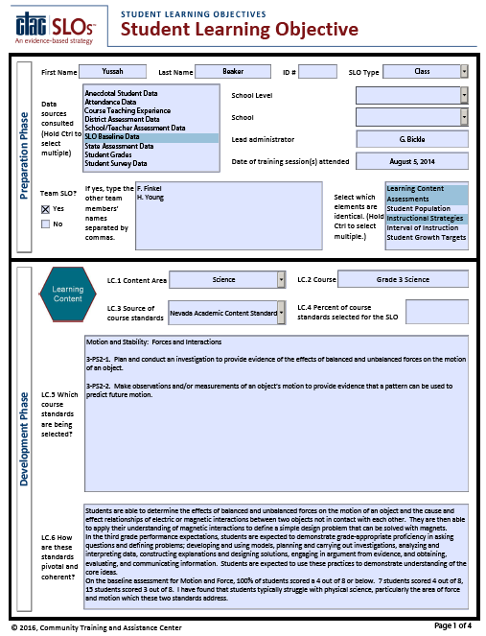
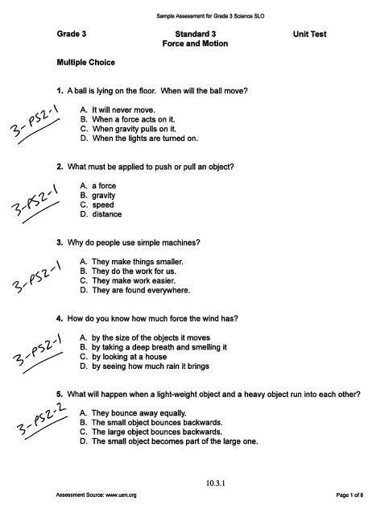
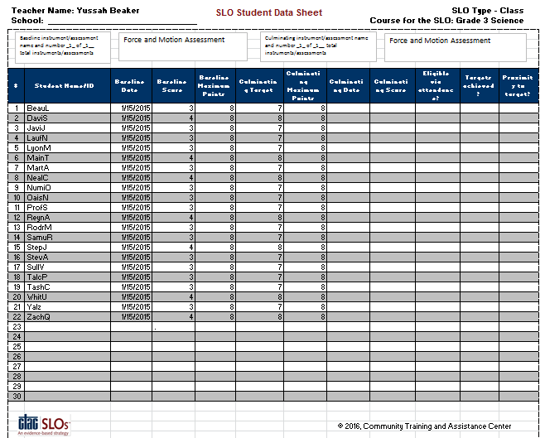
Reviewing an SLO – Grade 3 Science
Read the sample SLO
Jot notes on:
Higher quality features of the SLO
Lower quality features of the SLO

Slide 10
Quality Rating Rubric

Slide 11
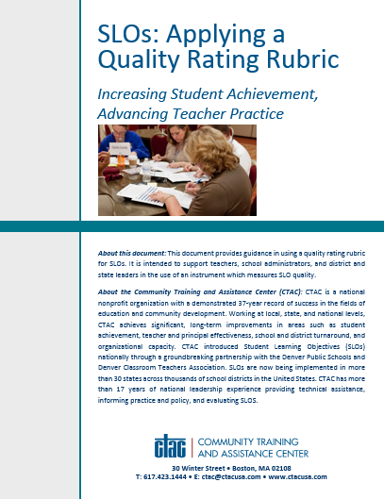
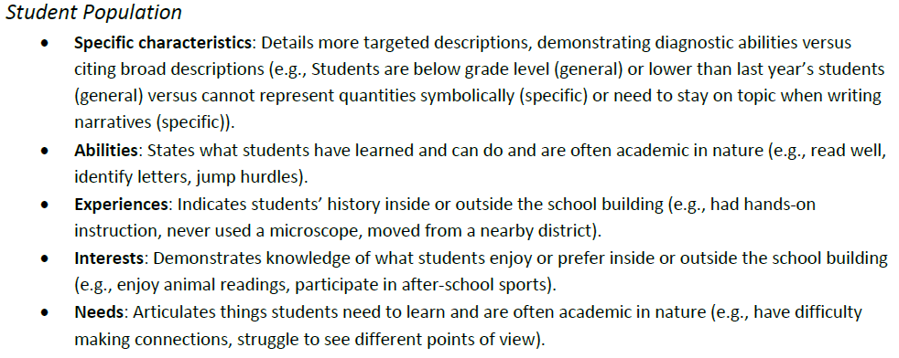
Rating an SLO
It may be helpful to refer to pages 3 and 4 of this resource when applying the rubric.

Slide 12
Rating an SLO
Review the Quality Rating Rubric and sample SLO.
Rate the SLO applying each row of the rubric.
Discuss and agree on a numeric rating with colleagues.
Craft one or more feedback statements to support this teacher.

Slide 13
Learning Content – Grade 7 ELA
Less than half the course set of standards
“…this class performed the lowest…” (SP.5)
Argumentation is writing mode most in need (LC.5)
Common theme of argumentative writing
4

Slide 14
Assessments – Grade 7 ELA
Identifies baseline and summative assessment
Measures conventions, not included
Performance-based task
Measures some content more than once (W.7.1.a and W.7.1.c)
1

Slide 15
Student Population – Grade 7 ELA
Student names and baseline scores are given, showing a need (all 2s and 4s out of 8)
Other data point to need
“Also, based on early writing samples…” (LC.5)
Abilities and needs are described
“…poor vocabularies” (SP.4)
“…a significant number of students (16) approaching…” (SP.4)
3

Slide 16
Instructional Strategies – Grade 7 ELA
3 strategies are identified
Analysis of student work
Word wall
Cooperative learning
Each strategy is described
“…students will…” (IS.2)
Analysis of student work is lacking a rationale
A general plan for differentiation is present
“…each week…talk about student progress…” (IS.4)
2

Slide 17
Interval of Instruction – Grade 7 ELA
Selects a start and stop date
Quantifies instructional time
Allows enough time for depth and complexity
Could be improved with a learning progression
3

Slide 18
Student Growth Targets – Grade 7 ELA
Baseline data and growth targets show the targets are sufficiently rigorous
Additional data in the rationale demonstrating why the rigor is high is needed (Grades 6-11)
3

Slide 19
Examples: SLO Annotations
Great Teachers and Leaders Center:
https://goo.gl/C70Dib
National Library:
https://rtt.grads360.org/#communities/slo/slo-library
New York State:
https://www.engageny.org/resource/slo-field-samples-year-2-implementation-2013-14

Slide 20
Learning Content – Grade 3 Science
Minimum of two standards
“…students scored a 4 out of 8 or below…”
“I have found…typically struggle…area of force and motion…”
Common theme of force and motion
4

Slide 21
Assessments – Grade 3 Science
Identifies baseline and summative assessment (same assessment)
Most items align
Blend of item types
At least four higher-order multiple-choice items
Measures each standard multiple times
1

Slide 22
Student Population – Grade 3 Science
Student names are given, showing a need (all are below standard)
Teacher states “…students typically struggle…these two standards…”
Need for the standards is highlighted, but not specifics or abilities
2

Slide 23
Instructional Strategies – Grade 3 Science
3 strategies are identified
Accountable talk
Discovery/Inquiry-based learning
Direct instruction
Narrative fields generally expound on the strategy
Missing evidence of effectiveness
Includes a plan for differentiation and describes modeling
1

Slide 24
Interval of Instruction – Grade 3 Science
Selects a start and stop date
Quantifies instructional time
Depth and complexity is allowed for given the total instructional time
Could be improved with a learning progression
3

Slide 25
Student Growth Targets – Grade 3 Science
Baseline data and growth targets show the targets are highly rigorous
It would be next to impossible to reach any higher for this area of need
3

Slide 26
Reflecting on SLO Quality
How can you introduce and use a quality rating rubric to improve practice?
How do you think a quality rubric will help your teachers and principals?

Slide 27
Navigating an SLO Process

Slide 28
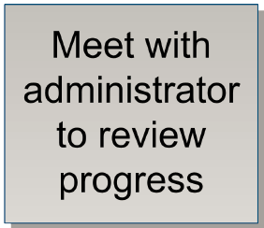
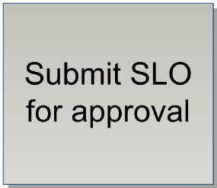
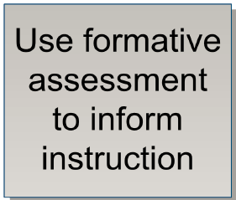
Key Actions
Review the key teacher actions involved in the SLO process.
Sequence them as you see best.
Review the work of colleagues.

Slide 29
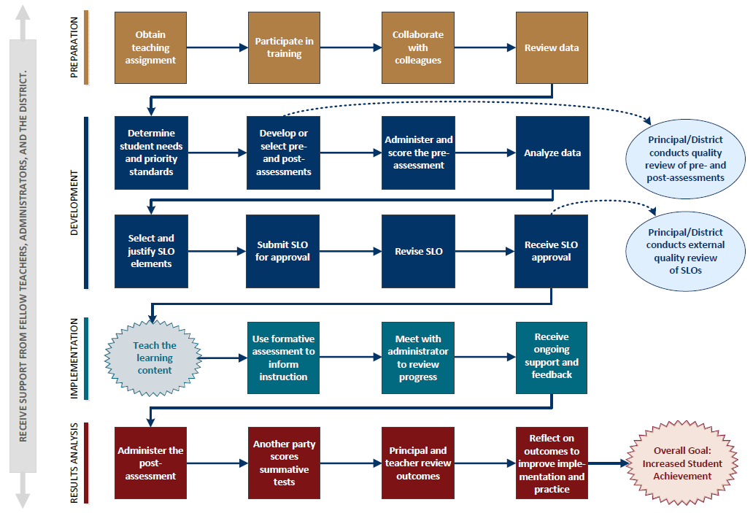
Sample Display of Key Actions

Slide 30
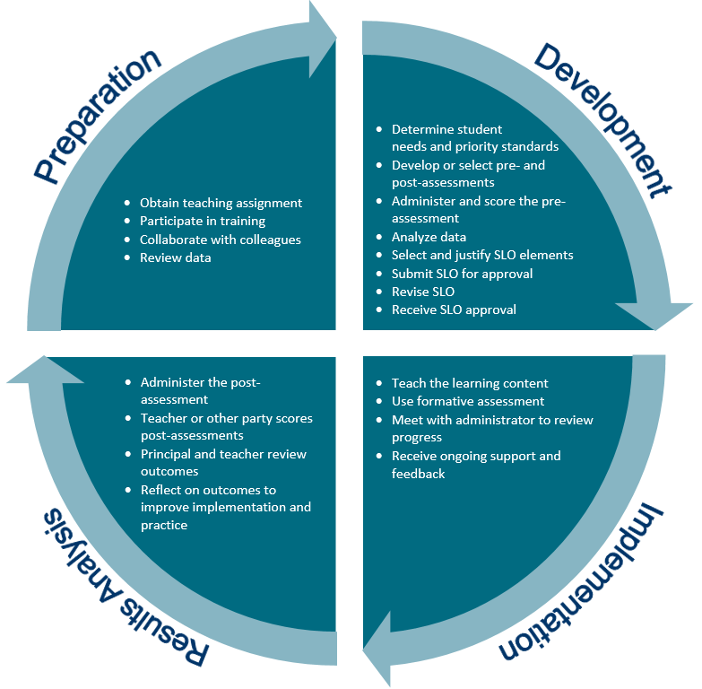
Sample Display of Key Actions

Slide 31
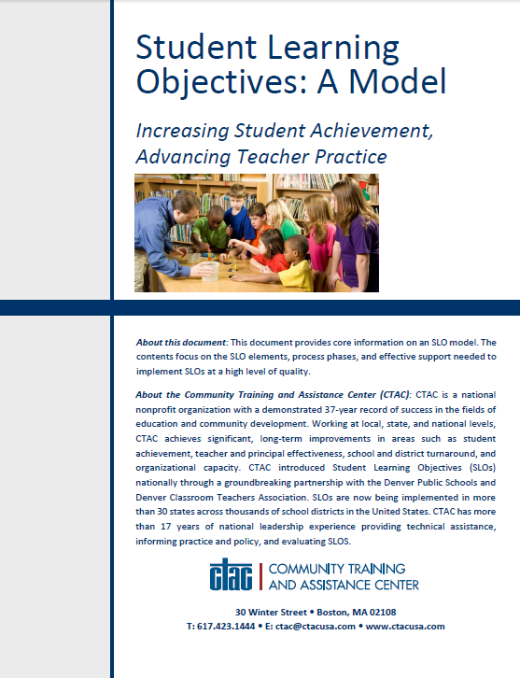
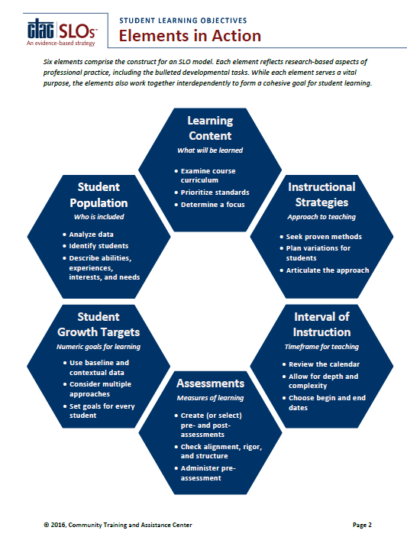
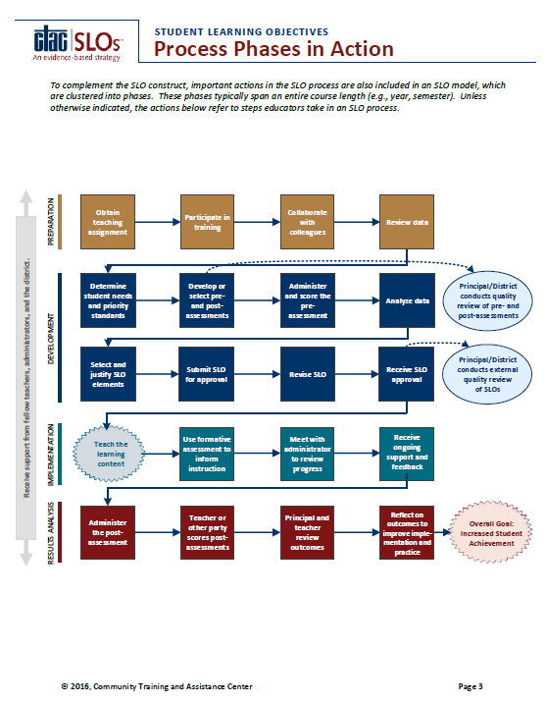
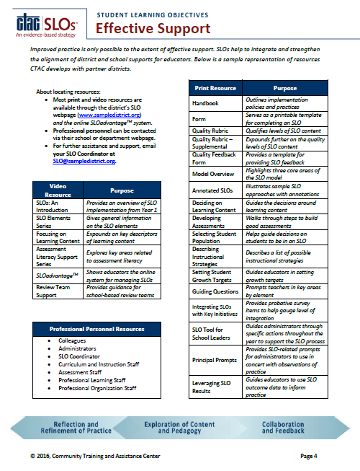
Sample SLO Model
Cover
Content
Process
Support

Slide 32
Key Actions
Think on your district’s expectations for teacher practice (NBPTS, Danielson, Marzano, etc.).
Find cards that name an existing expectation, discuss how the expectation is met, then turn it over face down.

Slide 33
Reflecting on the SLO Process
What are the top three areas of SLO implementation where teachers and principals will need support?
What specific support will you provide to teachers and principals in these areas?

Slide 34
Deciding on Learning Content

Slide 35
NBPTS Indicators*
SLOs: Learning Content
Knowledge of how students learn and develop (1.2)
Knowledge of subject domain content and linkages (2.1)
*or other teaching expectations

Slide 36
Sample Selections of Standards
Course: Grade K Physical Education
Source: Grade-Level Outcomes for K-12 Physical Education from Society of Health And Physical Educators (SHAPE) America
S1.E1.K Performs locomotor skills (hopping, galloping, running, sliding, skipping) while maintaining balance.
S1.E3.K Performs jumping and landing actions with balance.
S1.E5.K Performs locomotor skills in response to teacher-led creative dance.
S1.E7.Ka Maintains momentary stillness on different bases of support.
S1.E7.Kb Forms wide, narrow, curled and twisted body shapes.
S1.E9.K Rolls sideways in a narrow body shape.
S1.E10.K Contrasts the actions of curling and stretching.
S1.E13.K Throws underhand with opposite foot forward.
S1.E16.Ka Drops a ball and catches it before it bounces twice.
S1.E16.Kb Catches a large ball tossed by a skilled thrower.
S1.E17.K Dribbles a ball with one hand, attempting the second contact.
S1.E18.K Taps a ball using the inside of the foot, sending it forward.
S1.E21.K Kicks a stationary ball from a stationary position, demonstrating 2 of the 5 elements of a mature kicking pattern.
S1.E22.K Volleys a lightweight object (balloon), sending it upward.
S1.E24.K Strikes a lightweight object with a paddle or short-handled ra
Course: Visual Arts I
Source: National Core Arts Standards and Common Core State Standards
VA:Cr2.1.Ia Engage in making a work of art or design without having a preconceived plan.
VA:Pr5.1.Ia Analyze and evaluate the reasons and ways an exhibition is presented.
VA:Re.7.1.Ia Hypothesize ways in which art influences perception and understanding of human experiences.
VA:Re8.1.Ia Interpret an artwork or collection of works, supported by relevant and sufficient evidence found in the work and its various contexts.
VA:Re9.1.Ia Establish relevant criteria in order to evaluate a work of art or collection of works.
VA:Cn10.1.Ia Document the process of developing ideas from early stages to fully elaborated ideas.
VA:Cn11.1.Ia Describe how knowledge of culture, traditions, and history may influence personal responses to art.
WHST.9-10.4 Produce clear and coherent writing in which the development,
Course: Grade 7 English Language Arts (ELA)
Source: Common Core State Standards
W.7.1 - Write arguments to support claims with clear reasons and relevant evidence
W.7.1.a - Introduce claim(s), acknowledge alternate or opposing claims, and organize the reasons and evidence logically
W.7.1.b - Support claim(s) with logical reasoning and relevant evidence, using accurate, credible sources, and demonstrating an understanding of the topic or text
W.7.1.c - Use words, phrases, and clauses to create cohesion and clarify the relationship among claim(s), reasons, and evidence
W.7.1.d - Establish and maintain a formal style
W.7.1.e - Provide a concluding statement or section that follows from and supports the argument presented
W.7.4 - Produce clear and coherent writing in which the development, organization, and style are appropriate to task, purpose, and audience
W.7.8 - Gather relevant information from multiple print and digital sources, using search terms effectively, assess the credibility and accuracy of each source, and quote or
Course: Spanish I
Source: World-Readiness Standards for Learning Languages
Learners present information, concepts, and ideas to inform, explain, persuade, and narrate on a variety of topics using appropriate media and adapting to various audiences of listeners, readers, or viewers.
Course: Grade 5 Science
Source: Next Generation Science Standards
5-PS2-1 Support an argument that the gravitational force exerted by Earth on objects is directed down.
5-LS2-1 Develop a model to describe the movement of matter among plants, animals, decomposers, and the environment
5-ESS2 Describe and graph the amounts and percentages of water and fresh water in various reservoirs to provide evidence about the distribution of water on Earth.
Course: World History
Source: Unknown
Students will learn the key concepts associated with war and conflict.
Students will think about ways to prevent war and conflict.
Students will apply methods for reducing/eliminating war and conflict to various scenarios

Slide 37
Determining Quality Selections
Line up the sample selections of standards in order of lowest quality to highest quality
Course: Grade 5 Science
Source: Next Generation Science Standards
5-PS2-1 – Support an argument that the gravitational force exerted by Earth on objects is directed down.
5-LS2-1 – Develop a model to describe the movement of matter among plants, animals, decomposers, and the environment
5-ESS2 – Describe and graph the amounts and percentages of water and fresh water in various reservoirs to provide evidence about the distribution of water on Earth.
Course: World History
Source: Unknown
Students will learn the key concepts associated with war and conflict.
Students will think about ways to prevent war and conflict
Level 1 Level 2 Level 3 Level 4
Low Quality High Quality

Slide 38
Determining Quality Selections
Line up the sample selections of standards in order of lowest quality to highest quality
World History
Spanish
Science
Vis. Arts
PE
ELA
Level 1 Level 2 Level 3 Level 4

Slide 39
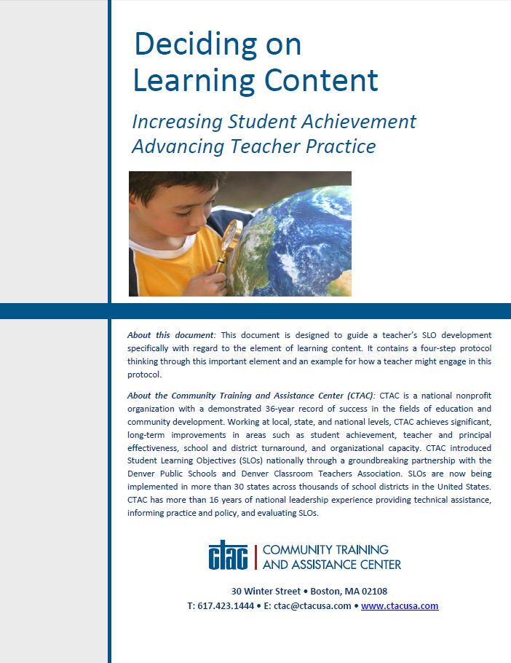
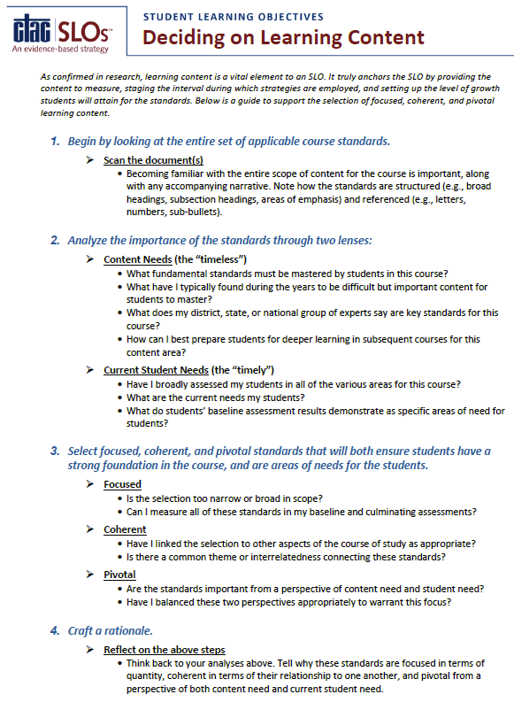
Deciding on Learning Content
Review the protocol.
Develop a visual summary of the process.
Discuss how this resource can be used in your district.

Slide 40
Reflecting on Learning Content
Do your teachers and principals understand how to determine the quality or appropriateness of a Learning Content selection?
What professional and leadership development is needed to guide educators to high quality selections of Learning Content?

Slide 41
Setting Growth Targets

Slide 42
Target Setting Guide
Based on 19 years of field experience and research
Follows a three-step pathway
Helps teachers and administrators think through key data

Slide 43
Target Setting Pathway
Collect and make sense of student data
Analyze the implications of different approaches for students
Set targets for each student

Slide 44
Target Setting Approaches
Common Growth
Growth to Mastery
Banded
Status
Half the Gap
Individualized

Slide 45
Common Growth Approach
Student | Baseline | Target
A | 50 of 100 | 70 of 100
B | 70 of 100 | 90 of 100
C | 55 of 100 | 75 of 100

Slide 46
Growth to Mastery Approach
Student | Baseline | Target
A | 3 of 10 | 7 of 10
B | 2 of 10 | 7 of 10
C | 4 of 10 | 7 of 10

Slide 47
Banded Approach
Student | Baseline | Target
A | 8/10 (high) | 10 of 10
B | 6/10 (high) | 8 of 10
C | 3/10 (low) | 7 of 10

Slide 48
Status Approach
Student | Baseline | Target
A | Emerging | Proficient
B | Proficient | Exceeding
C | Novice | Emerging

Slide 49
Half the Gap Approach
Student | Baseline | Target
A | 10 of 100 | 55 of 100
B | 75 of 100 | 88 of 100
C | 50 of 100 | 75 of 100

Slide 50
Individualized Approach
Student | Baseline | Target
Student A | 10 | 70
Student B | 20 | 75
Student C | 5 | 70
Student D | 0 | 65
Student E | 30 | 95
Student F | 10 | 75

Slide 51
Analyzing Approaches
Review the approaches to target setting.
Chart the pros and cons for each approach.
Approach | Pros | Cons
Common Growth
Growth to Mastery
Banded
Status
Half the Gap
Individualized

Slide 52
Closing Thoughts on Target Setting
Consider the whole SLO when setting targets.
Teacher knowledge of students and understanding of data are key.
Target setting needs to meet three standards of validity:
Statistical
Educational
Political

Slide 53
Reflecting on Target Setting
Which approach(es) to target setting would you recommend be permitted in an SLO process?
How can you help make others aware of the various approaches to setting student growth targets?

Slide 54
Developing Quality Assessments

Slide 55
Developing Quality Assessments
Use the Developing Quality Assessments protocol to analyze an SLO assessment.
Grade 3 Science and Grade 7 ELA examples are available.

Slide 56
Reflecting on Assessments
How would you characterize the quality level of assessments used in the SLO process?
How can you help advance the work of improving assessments in the SLO process?

Slide 57
Closing and Next Steps

Slide 58
Thank you!

